Slide 1
Accreditation Support for Teachers
Introduction to Accreditation at Proficient Teacher
Module 1 of 5
Notes:
Tips
Keep the title short
This is a presentation, not an academic journal article. If you need more than five words to capture the main idea, it’s not the main idea.
Here are some tips: use the sub-head to qualify or describe your title if necessary. Don’t use “BOSTES” in the title; that’s what the logo is for.
Identify the date and audience
There are a couple of reasons to include a date and audience. First, it’s polite to show you know who you are speaking to. Second, we use a single presentation on a number of occasions and this is a form of version control.

Slide 2
Module 1:
Accreditation with The Board of Studies Teaching and Educational Standards
www.nswteachers.nsw.edu.au

Slide 3
BOSTES
  The Board of Studies, Teaching and Educational Standards (BOSTES) oversees the system of accreditation in NSW:
  To support quality teaching in all NSW schools
  To advance the status and standing of the teaching profession
www.nswteachers.nsw.edu.au

Slide 4
Other regulatory authorities
Nursing: NSW Nurses and Midwives Registration Board
Dentistry: Australian Dental Association
Law: The Law Society of NSW
Social Work: Australian Association of Social Workers
Engineering: The Institute of Engineers, Australia
Psychology: Psychologists Registration Board
Accountancy: Certified Practicing Accountants, Australia
www.nswteachers.nsw.edu.au
Notes:
Gault

Slide 5
Quality Teaching Council
Representing the views of NSW teachers and the community, the QTC plays a pivotal role in shaping the future of the teaching profession in NSW.
Council members, who are either elected by their peers or appointed by the Minister, are directly involved in developing teacher accreditation policy in NSW.
At the heart of the QTC’s mission is building the profession’s capacity to protect its standards.
www.nswteachers.nsw.edu.au
Notes:
Gault

Slide 6
What does the Council do?
The QTC meets bimonthly to advise the Board of Studies, Teaching and Educational Standards (BOSTES) about:
teacher accreditation policy, including Great Teaching, Inspired Learning reforms
the use of the Australian Professional Standards for Teachers
ongoing professional learning for teachers
initiatives to support quality teaching.
www.nswteachers.nsw.edu.au

Slide 7
What does the Council do?
The QTC also:
recommends initial teacher education programs for accreditation
endorses providers of continuing professional development for teachers
provides a key channel for teachers and the community to address issues in teacher accreditation.
www.nswteachers.nsw.edu.au

Slide 8
BOSTES Directorates:
  Initial Teacher Education:
  Approves initial teacher education programs in NSW
  Teacher Accreditation
  Conducts the assessment of qualifications for teachers wanting to teach in NSW.
  Accredits teachers as provisional or conditional
www.nswteachers.nsw.edu.au

Slide 9
BOSTES Directorates
Teaching Standards
Monitors the accreditation process across NSW
Manages and supports the use of external assessors for quality control in the accreditation process
Professional Learning
Approves providers of courses and programs relevant to accreditation
www.nswteachers.nsw.edu.au
Notes:
Gault

Slide 10
Accreditation
www.nswteachers.nsw.edu.au

Slide 11
The purpose of Accreditation
Accreditation ensures a structured induction to the profession
Accreditation recognises and certifies a teacher’s achievement
Accreditation at Proficient Teacher is mandatory and follows a period of teaching practice
Accreditation at this level is a school-based process
www.nswteachers.nsw.edu.au

Slide 12
WHO IS ACCREDITED?
  Accreditation is mandatory for:
  teachers who started teaching after 1 October 2004, or
  teachers who have returned to teaching after an absence of five or more years.
  From 2018, existing teachers and early childhood teachers will be accredited at Proficient Teacher level and will need to maintain their accreditation.
www.nswteachers.nsw.edu.au
Notes:
Notes
Focus on key messages
Avoid unnecessary details
Organise points from the most to the least important
Aim for three points per slide and six words per point
Use graphs in your slides, images to complement your words
Graphs provide a visual summary of data and are easy for the audience to process (column, pie, line etc)
Flowcharts show relationships, milestones and processes
Tables keep things neat (timelines, agenda items etc)
A picture is worth a thousand words – consider using screenshots to show your point
Videos allow you to show rather than tell, and can reinforce your message
Make handouts from speaker notes

Slide 13
Teacher Accreditation authority
A teacher accreditation authority (TAA) is the person or body authorised to determine if a teacher meets the requirements for accreditation.
  For teachers seeking provisional or conditional accreditation, this is the BOSTES
  For Proficient Teacher accreditation the TAA is:
  the Director, Public Schools in the government sector
  the Diocesan Director in Catholic systemic schools
  the Principal in most independent schools
www.nswteachers.nsw.edu.au

Slide 14
Teacher Accreditation authority
The TAA is responsible for managing and monitoring teachers’ accreditation by:
maintaining a record of accreditation
completing a report on the teacher’s practice against the Standards
www.nswteachers.nsw.edu.au
Notes:
Gault

Slide 15

The Australian Professional standards for teachers
www.nswteachers.nsw.edu.au

Slide 16
The Australian Professional standards for teachers
The Standards:
are a public statement of what constitutes quality teaching
define the work of teachers
make explicit the elements of high quality, effective teaching in 21st century schools
provide a framework for that describes the knowledge, practice and professional engagement required across teachers’ careers.
provide a common language between teachers, teacher educators, organisations and the public
www.nswteachers.nsw.edu.au
Notes:
Michele

Slide 17
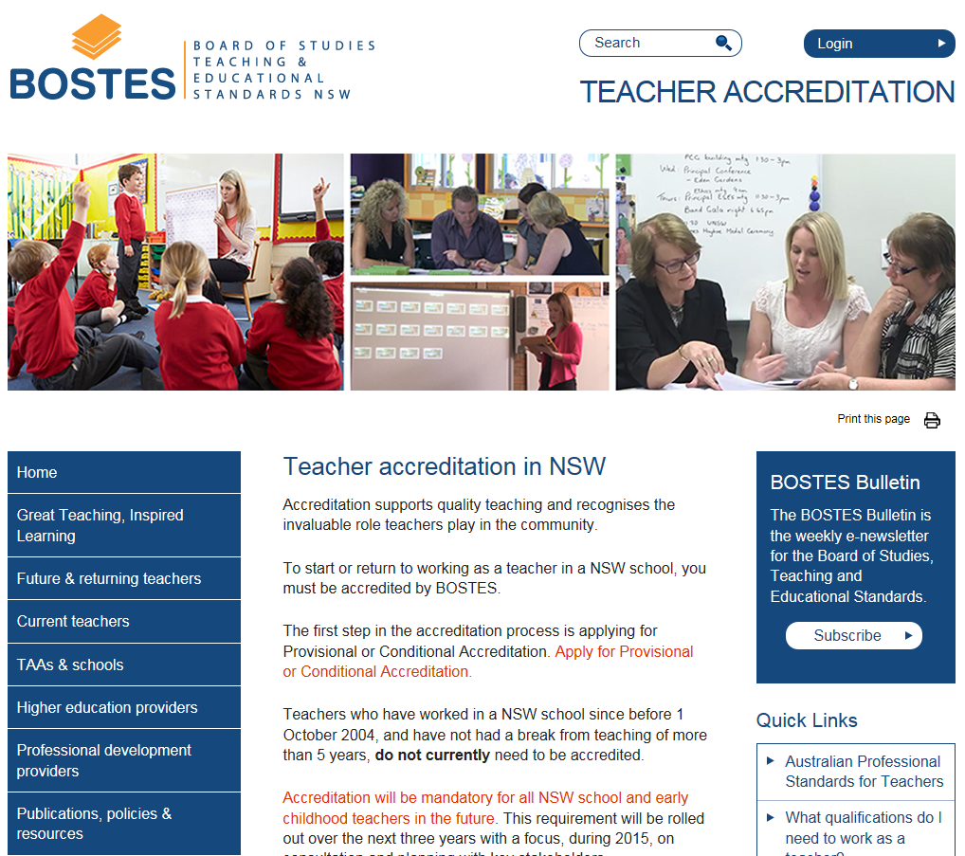
BOSTES TEACHER ACCREDITATION WEBSITE
  www.nswteachers.nsw.edu.au
www.nswteachers.nsw.edu.au

Slide 18
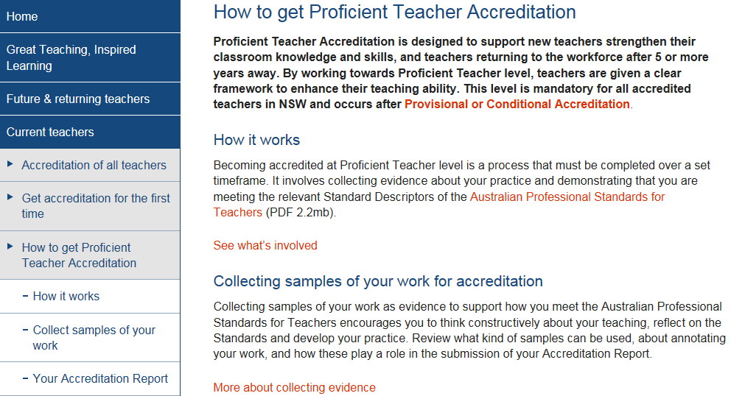
Current Teachers section
Resources for teachers working towards accreditation at Proficient Teacher:
www.nswteachers.nsw.edu.au

Slide 19
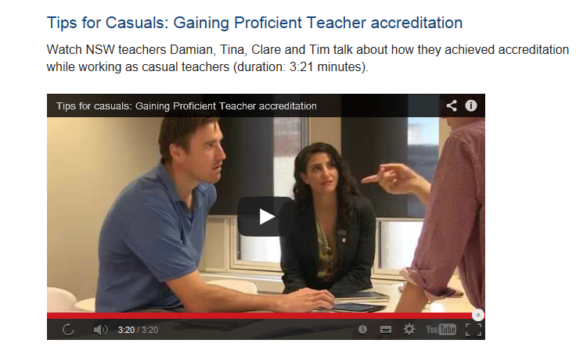
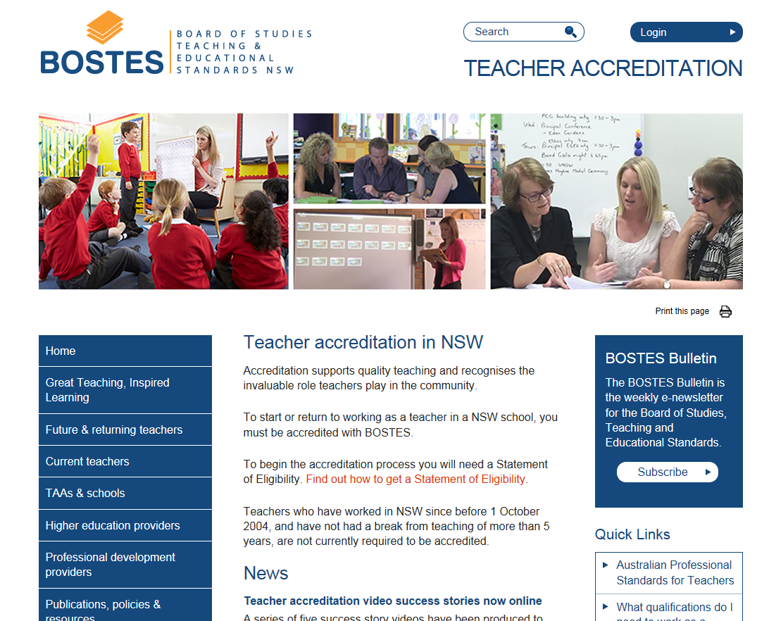
BOSTES TEACHER ACCREDITATION WEBSITE
  Additional resources available on the BOSTES website:
Login
Videos, templates, policies, how to guides and booklets
www.nswteachers.nsw.edu.au
Notes:
Notes
Focus on key messages
Avoid unnecessary details
Organise points from the most to the least important
Aim for three points per slide and six words per point
Use graphs in your slides, images to complement your words
Graphs provide a visual summary of data and are easy for the audience to process (column, pie, line etc)
Flowcharts show relationships, milestones and processes
Tables keep things neat (timelines, agenda items etc)
A picture is worth a thousand words – consider using screenshots to show your point
Videos allow you to show rather than tell, and can reinforce your message
Make handouts from speaker notes

Slide 20
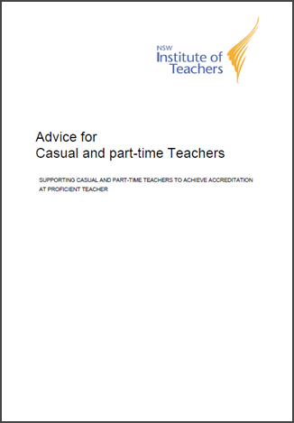



PROFICIENT TEACHER RESOURCES
www.nswteachers.nsw.edu.au
Notes:
Notes
Focus on key messages
Avoid unnecessary details
Organise points from the most to the least important
Aim for three points per slide and six words per point
Use graphs in your slides, images to complement your words
Graphs provide a visual summary of data and are easy for the audience to process (column, pie, line etc.)
Flowcharts show relationships, milestones and processes
Tables keep things neat (timelines, agenda items etc.)
A picture is worth a thousand words – consider using screenshots to show your point
Videos allow you to show rather than tell, and can reinforce your message
Make handouts from speaker notes

