Slide 1
Accreditation Support for Teachers
Introduction to Accreditation at Proficient Teacher
Module 2 of 5
Notes:
Tips
Keep the title short
This is a presentation, not an academic journal article. If you need more than five words to capture the main idea, it’s not the main idea.
Here are some tips: use the sub-head to qualify or describe your title if necessary. Don’t use “BOSTES” in the title; that’s what the logo is for.
Identify the date and audience
There are a couple of reasons to include a date and audience. First, it’s polite to show you know who you are speaking to. Second, we use a single presentation on a number of occasions and this is a form of version control.

Slide 2
Module 2:
The Australian professional standards for teachers
www.nswteachers.nsw.edu.au

Slide 3
The Standards
  The Board of Studies, Teaching and Educational Standards (BOSTES) worked closely with the Australian Institute of Teaching and School Leadership (AITSL) in the development of the Australian Professional Standards for Teachers (the Standards).
  The Standards are at the core of BOSTES work.
  The Standards describe what teachers need to know, understand and do to teach effectively.
www.nswteachers.nsw.edu.au
Notes:
Michele

Slide 4

The Australian Professional standards for teachers
www.nswteachers.nsw.edu.au

Slide 5
The standards
The Standards:
are a public statement of what constitutes quality teaching.
define the work of teachers.
make explicit the elements of high quality, effective teaching in 21st century schools.
provide a framework that describes the knowledge, practice and professional engagement required across teachers’ careers.
provide a common language between teachers, teacher educators, educational organisations and the public.
www.nswteachers.nsw.edu.au
Notes:
Michele

Slide 6
The Standards Framework
There are:
four career stages, to provide a foundation for the accreditation of teachers
three Domains
seven Standards
37 Standard Descriptors
www.nswteachers.nsw.edu.au
Notes:
Michele

Slide 7
THE FOUR CAREER STAGES
  The four career stages in the Standards provide benchmarks to recognise the professional growth of teachers throughout their careers.
  Mandatory levels:
  Graduate Teacher
  Proficient Teacher
  Voluntary levels:
  Highly Accomplished
  Lead Teacher
www.nswteachers.nsw.edu.au
Notes:
Michele

Slide 8
Organisation of the Standards
DOMAIN
STANDARD
FOCUS
STANDARD DESCRIPTOR
www.nswteachers.nsw.edu.au
Notes:
Michele

Slide 9
Three Domains of Teaching
Professional Knowledge
Standards 1 & 2
Professional Practice
Standards 3, 4 & 5
Professional Engagement Standards 6 & 7
www.nswteachers.nsw.edu.au
Notes:
Michele

Slide 10
Seven STANDARDS
Professional Knowledge
Standard 1 Know students and how they learn
Standard 2 Know the content and how to teach it
Professional Practice
Standard 3 Plan and implement effective teaching and learning
Standard 4 Create and maintain supportive and safe learning environments
Standard 5 Assess, provide feedback and report on student learning
Professional Engagement
Standard 6 Engage in professional learning
Standard 7 Engage professionally with colleagues, parents/carers and the community
www.nswteachers.nsw.edu.au
Notes:
Michele

Slide 11
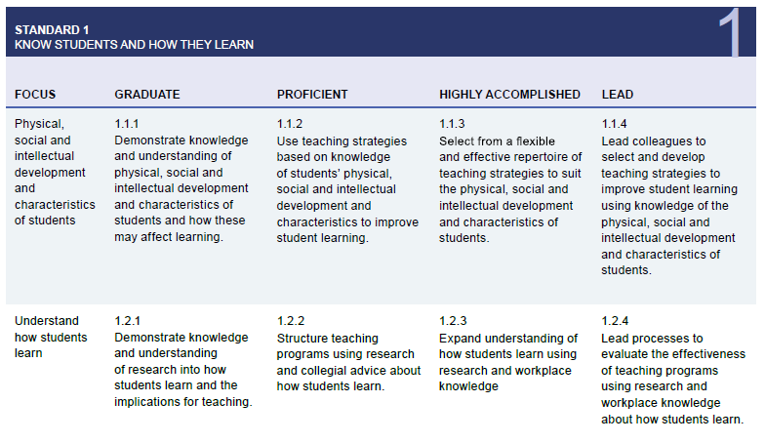
ORGANISATION OF THE STANDARDS
Standard
Career Stage
Focus
Standard Descriptor/s
www.nswteachers.nsw.edu.au
Notes:
Michele

Slide 12
Knowing the Standards
  Activity 1 – Proficient Teacher
  Read the professional capability of Proficient Teachers on page 6 of the Standards booklet.
  In general terms, what can a Proficient Teacher do?
www.nswteachers.nsw.edu.au
Notes:
Michele

Slide 13
Professional Capabilities
Create effective teaching and learning experiences
Adjust teaching to meet individual student needs
Know the unique backgrounds of their students
Develop safe, positive, productive learning environments
www.nswteachers.nsw.edu.au

Slide 14
Professional Capabilities
Encourage all students to participate
Design and implement engaging teaching programs, that meet curriculum, assessment and reporting guidelines
Use feedback and assessment to analyze and support their students
Behave professionally and ethically
www.nswteachers.nsw.edu.au

Slide 15
Professional Capabilities
Use a range of sources, including student results, to evaluate their teaching and adjust programs to better meet student needs
Be an active member of the profession
Work collaboratively with colleagues and communicate effectively
Behave professionally and ethically in all forums
www.nswteachers.nsw.edu.au

Slide 16
Knowing the Standards
  Suggested activities to develop your knowledge of the Standards at the Proficient Teacher level:
  Highlight the verbs (indicators of practice) that describe the level of Proficient Teacher in each of the 37 Standard Descriptors.
  Consider the difference in teaching practice between the Graduate and the Proficient level.
www.nswteachers.nsw.edu.au

